Slide 1
Lecture 20
Confidence Levels and Critical Values

Slide 2
Review
1 In “we are 95% confident”, what is the 95% about?
The method: about 95% of intervals built this way capture the parameter.
2 What is the 95% interval for p, and when does it work?
p̂ ± 2√(p̂(1 − p̂) / n), when np̂ > 5 and n(1 − p̂) > 5.
3 Where does the 2 in “± 2 SE” come from?
95% of a normal curve lies within 1.96 SD of the mean; 2 is 1.96 rounded.

Slide 3
Why 95%?
Every interval on Monday was estimate ± 2 SE, which captures the parameter about 95% of the time.
A cardiologist wants to be 99% sure instead.
(a) Should the interval get wider or narrower?
(b) What in “estimate ± 2 SE” has to change?
(a) Wider: more confidence needs a bigger net
(b) The 2 becomes a bigger number, the critical value

Slide 4
Confidence levels
confidence level C
the share of all possible samples whose interval captures the parameter: 90%, 95%, 99%
α
the share that miss: α = 1 − C, split as α/2 in each tail
critical value z_{1−α/2}
the z with area 1 − α/2 to its left; the interval is estimate ± z × SE

Slide 5
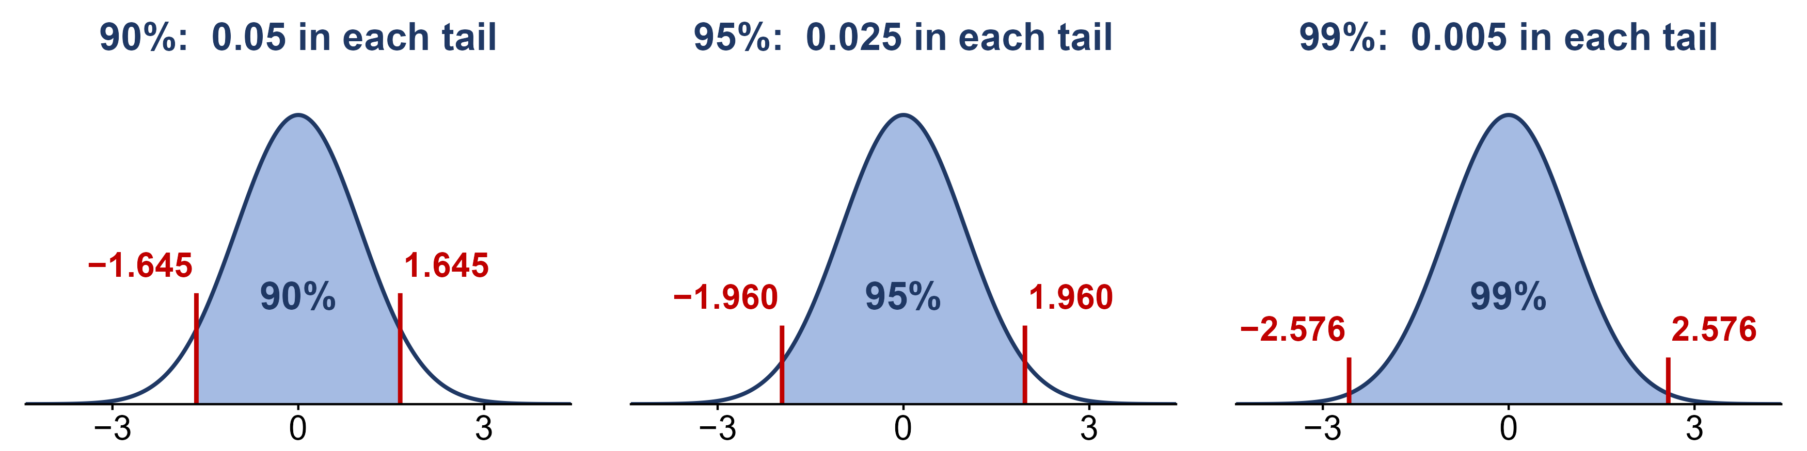
Where z comes from
The middle C of the standard normal curve is shaded; α/2 is left in each tail.
For a 90% interval, what area to the LEFT of z do we look up in the z-table?
90%: 1 − 0.05 = 0.95 → z = 1.645 95%: 0.975 → 1.960 99%: 0.995 → 2.576

Slide 6
Example: critical values
Find the area 1 − α/2 inside the z-table, then read off z.
C = 80%; C = 90%; C = 99%
(a) What is α/2 for each?
(b) What area to the left do we look up?
(c) What is the critical value?
80%: α/2 = 0.10, area 0.90 → z = 1.28
90%: α/2 = 0.05, area 0.95 → z = 1.645 (halfway between 1.64 and 1.65)
99%: α/2 = 0.005, area 0.995 → z = 2.576 (between 2.57 and 2.58)

Slide 7
Data: a gene and a drug
Clopidogrel (Plavix), a blood thinner used after heart attacks and stents, is switched on by the liver enzyme CYP2C19. People with the CYP2C19*2 variant switch on less of it.
X = 1 if a person carries at least one copy of *2, and 0 otherwise
PERSON | POPULATION | GENOTYPE | COPIES OF *2 | X
HG00403 | Southern Han Chinese | G/G | 0 | 0
HG00404 | Southern Han Chinese | A/A | 2 | 1
HG00406 | Southern Han Chinese | G/A | 1 | 1
HG00407 | Southern Han Chinese | G/G | 0 | 0
HG00409 | Southern Han Chinese | G/G | 0 | 0
… | … | … | … | …
n = 504 East Asian participants of the 1000 Genomes Project, which sequenced 2,504 people worldwide to catalog human genetic variation

Slide 8
Example: carriers of CYP2C19*2
Estimate p, the proportion of all individuals of East Asian descent who carry the *2 variant.
277 of n = 504 people are carriers
(a) What is p̂? Is the check met? What is the standard error?
(b) What are the 90%, 95% and 99% confidence intervals for p?
(c) Can we say more than half of people carry *2?
(a) p̂ = 277 / 504 ≈ 0.550; 277 and 227 are both > 5
SE = √(0.550 × 0.450 / 504) ≈ 0.022
(b) 90%: 0.550 ± 1.645(0.022): 0.514 to 0.586
95%: 0.550 ± 1.960(0.022): 0.507 to 0.593
99%: 0.550 ± 2.576(0.022): 0.493 to 0.607
(c) At 90% and 95%, yes; the 99% interval includes 0.5

